Slide 1
Overview on SAP Business ByDesign
PHUCDT4

Slide 2
What is it ?
Architecture
System Landscape
User Roles
Extension
SAP Cloud Application Studio
Resources

Slide 3
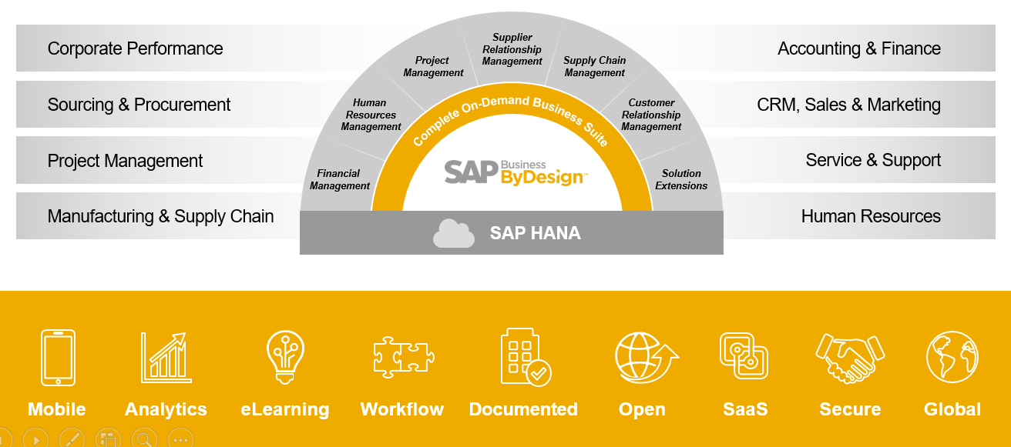
What is it ?

Slide 4
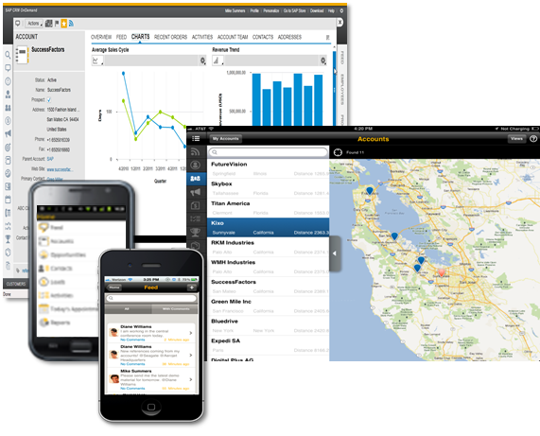
What is it ?
Notes:
Run on Silverlight và HTML5

Slide 5
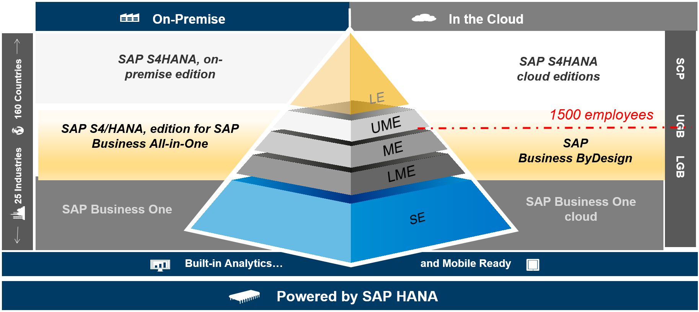
What is it ?

Slide 6
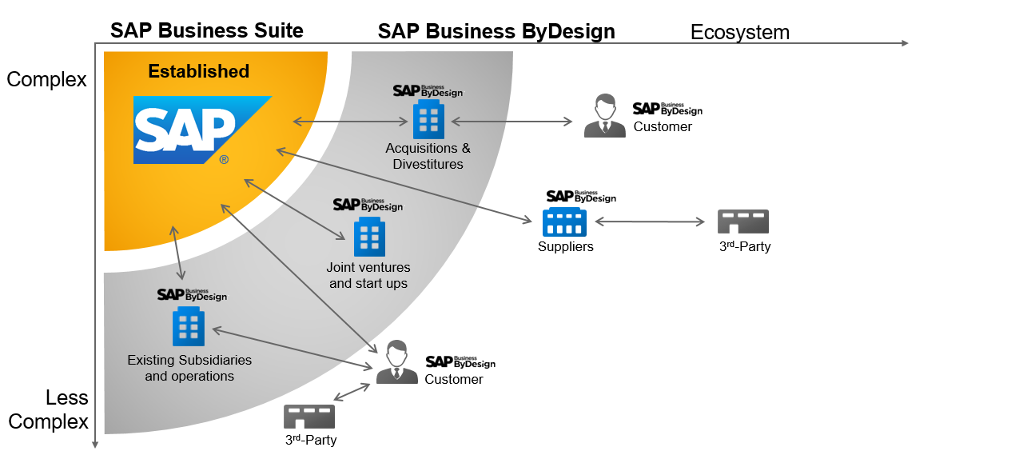
What is it ?

Slide 7
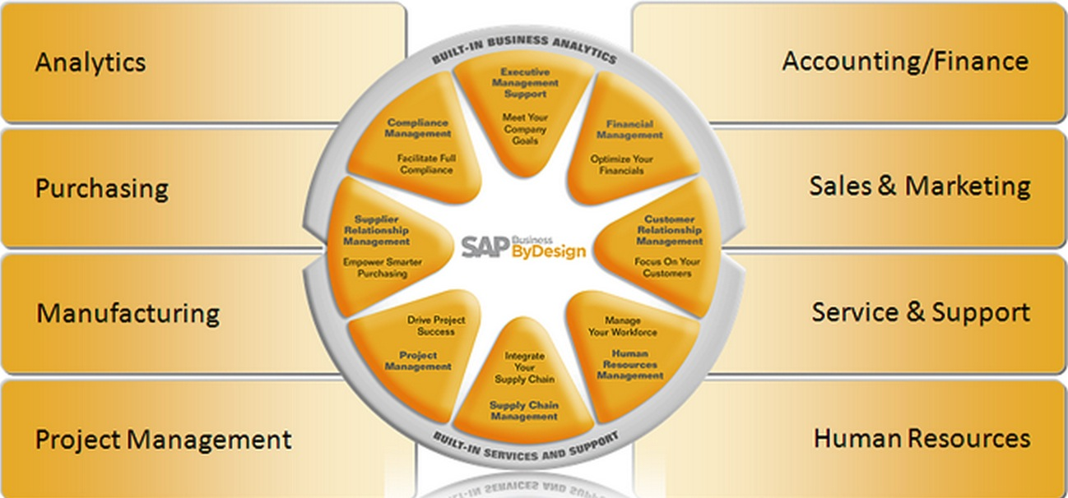
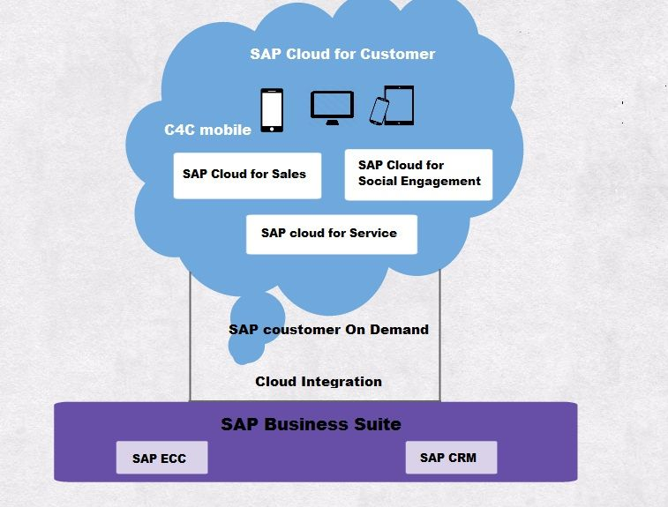
SAP Cloud For Customer (C4C) and SAP Business ByDesign (ByD)
SAP ByD involves many End to End Scenarios like Finance, HR, PP, MM… but limited CRM capabilities.
SAP C4C is a line of business solution with full focus on Sales & Service.
Notes:
As an example, in C4C you can create a lead, progress to opportunity, create quote & sales order but would not be able to do goods issue, invoicing & financial settlement. These have to be done on an on-premise solution like SAP ECC or a cloud based ERP solution like ByD.

Slide 8
What is SAP Business ByDesign ?
Architecture
System Landscape
User Roles
Extension
SAP Cloud Application Studio
Resources

Slide 9
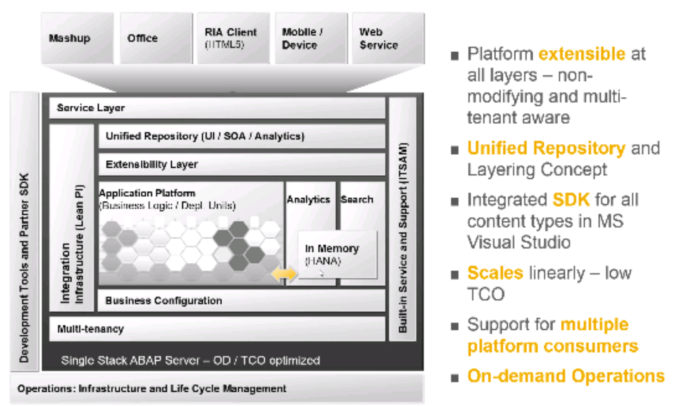
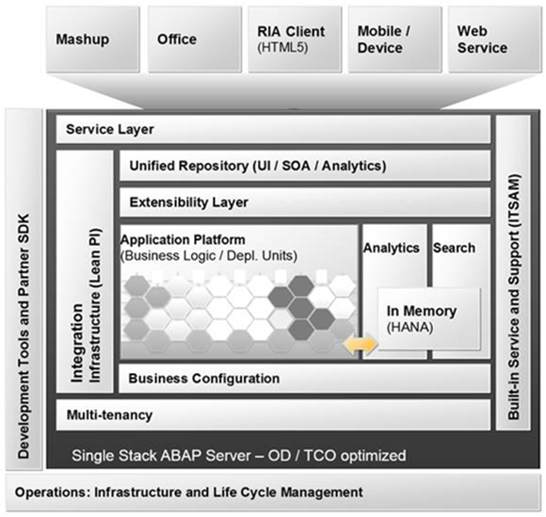
Architecture

Slide 10
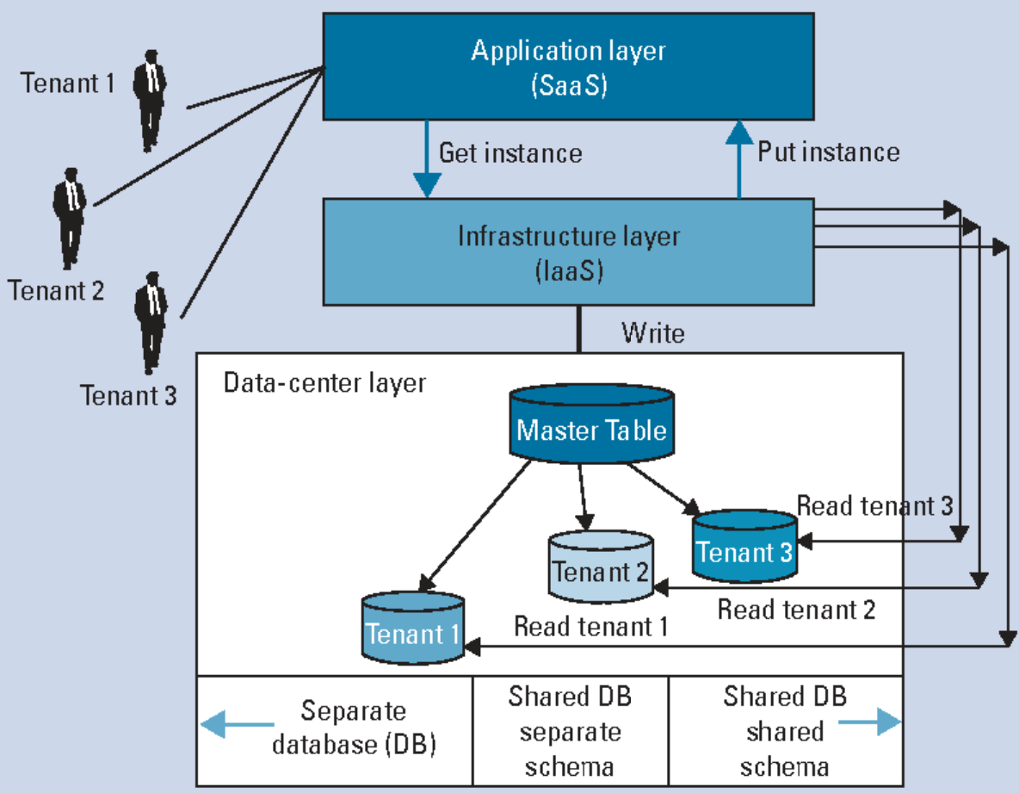
Architecture
Multitenancy Cloud Architecture
Notes:
Multitenancy
SOA ( Service Oriented Architecture )
ON SAP HANA ( in memory technology )

Slide 11
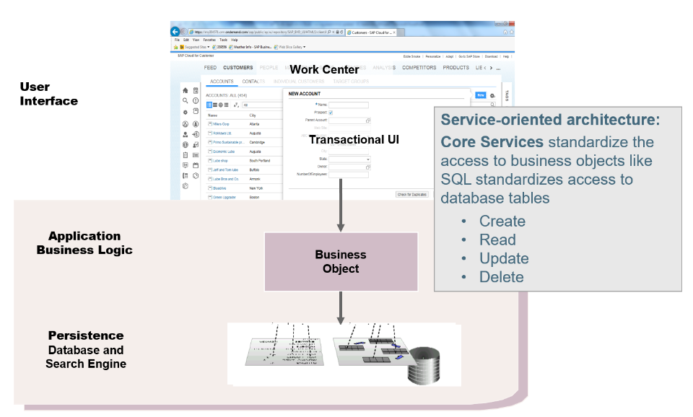
Architecture

Slide 12
What is it ?
Architecture
System Landscape
User Roles
Extension
SAP Cloud Application Studio
Resources

Slide 13
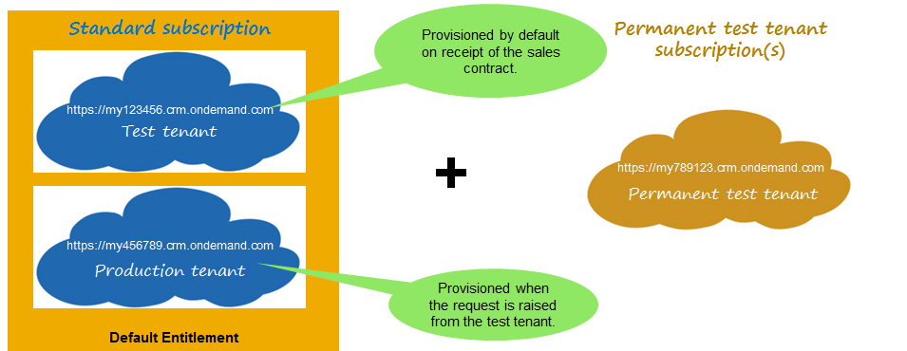
System Landscape

Slide 14
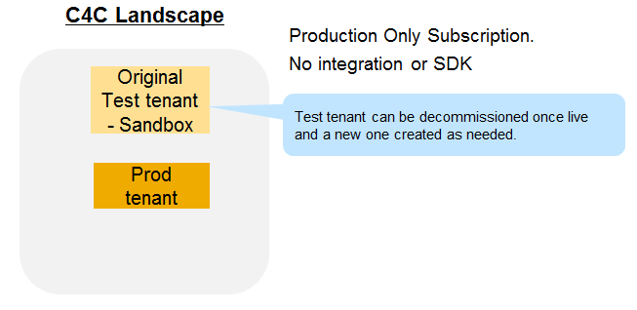
System Landscape
Use Case 1 (Cost Effective)

Slide 15
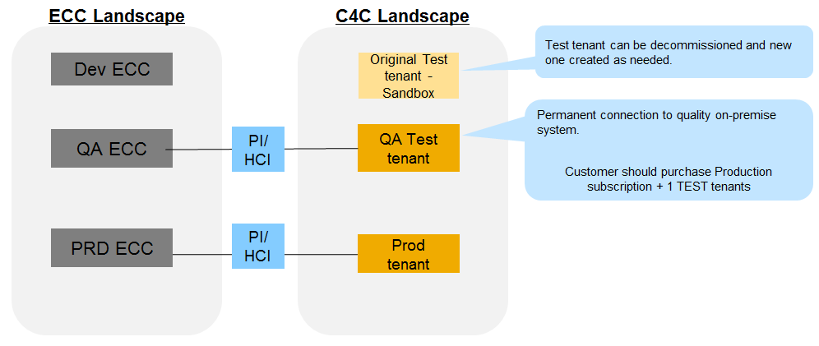
System Landscape
Use Case 2 (Standard)

Slide 16
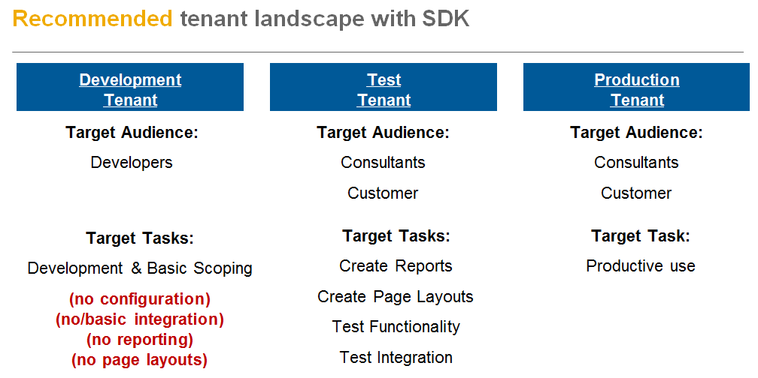
System Landscape

Slide 17
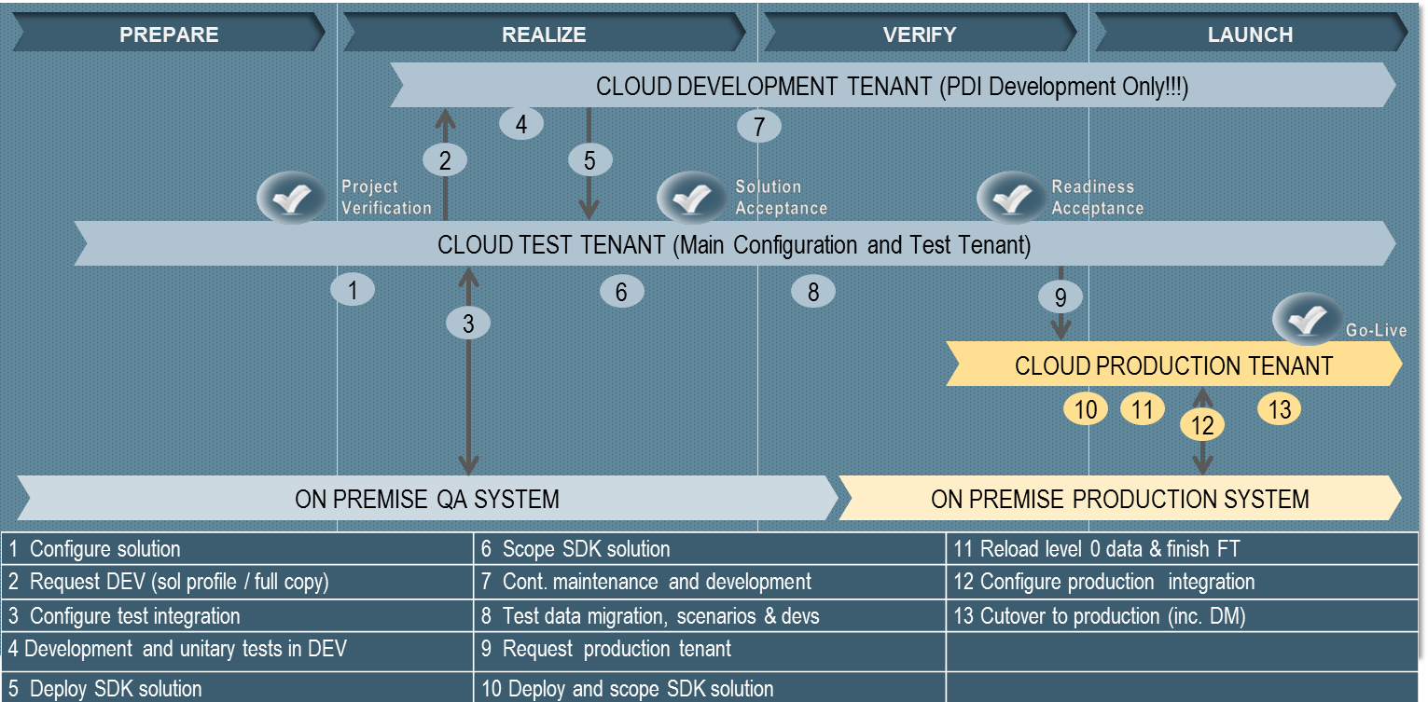
System Landscape

Slide 18
What is it ?
Architecture
System Landscape
User Roles
Extension
SAP Cloud Application Studio
Resources

Slide 19
User Roles
In SAP Business ByDesign users are categorized in 3 roles
Developer:
Create and maintain all types of development objects in cloud application studio, (i.e., Developer can be creating new business objects, user interfaces, forms, web services, whatever it might be.)
Access work center views for analytics
Studio administrator:
Create new solutions in Cloud Application studio
Delete solutions
Create patch requests
Business user:
Used for testing within a development or test tenant
Authorizations equal to a user on a customer tenant
No authorization for studio access (no access to Partner Development work center!)

Slide 20
What is it ?
Architecture
System Landscape
User Roles
Extension
SAP Cloud Application Studio
Resources

Slide 21
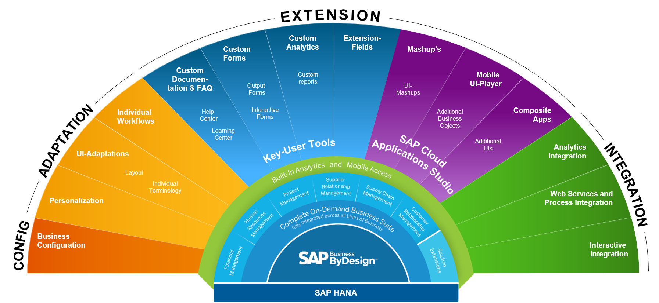
Extension - Overview

Slide 22
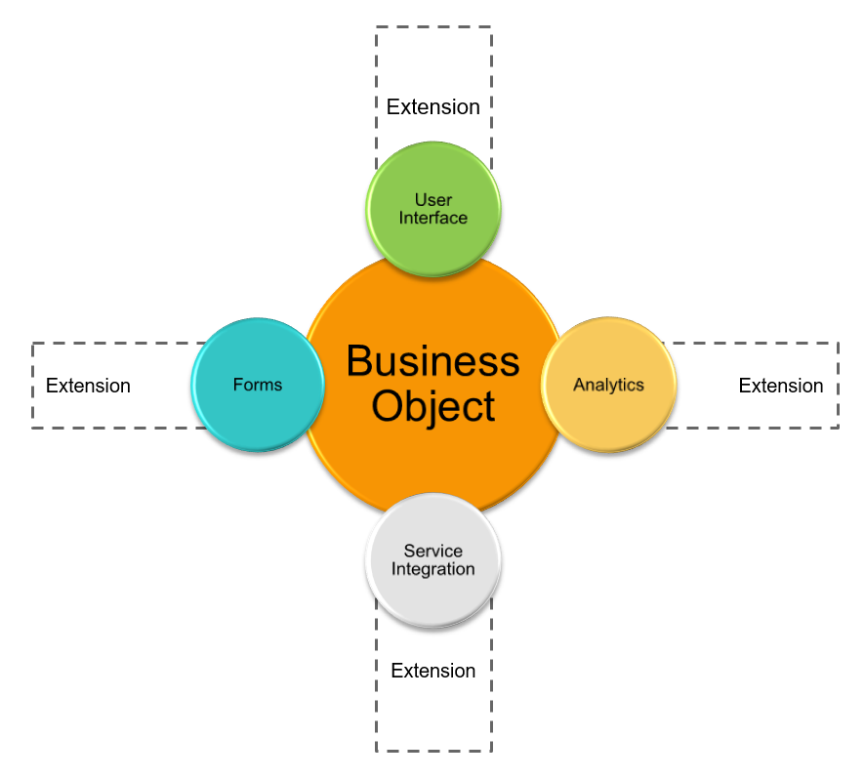
Extension - Overview

Slide 23
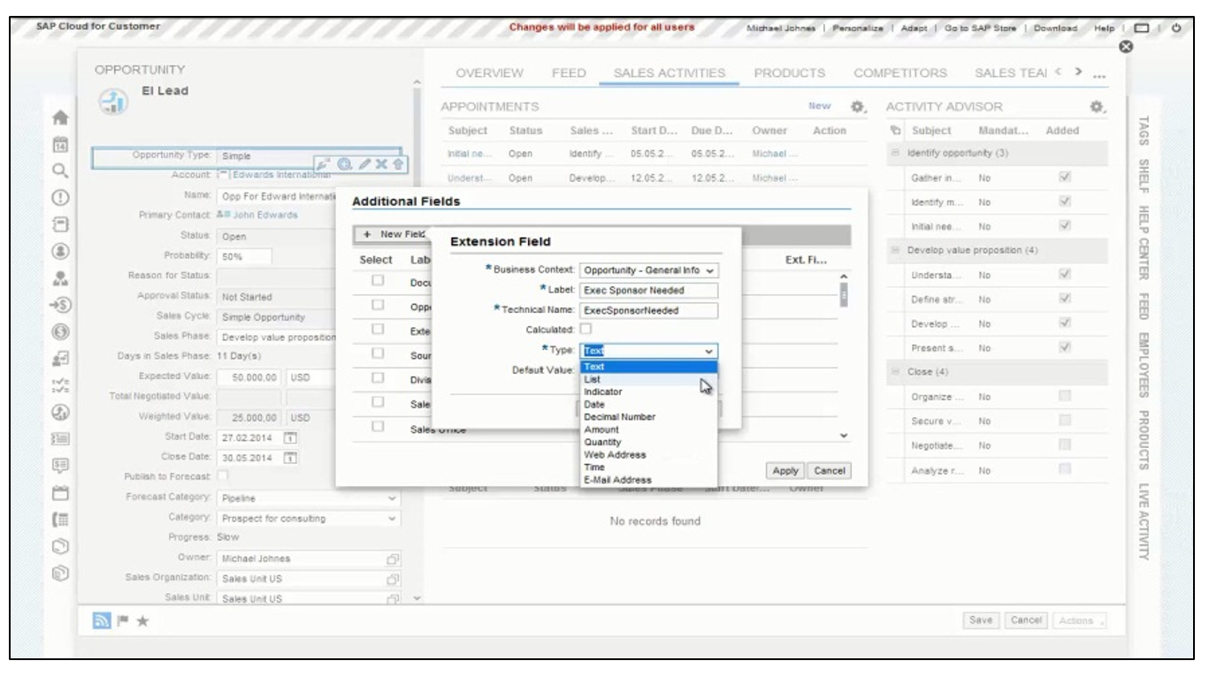
Extension – Key User Tools

Slide 24
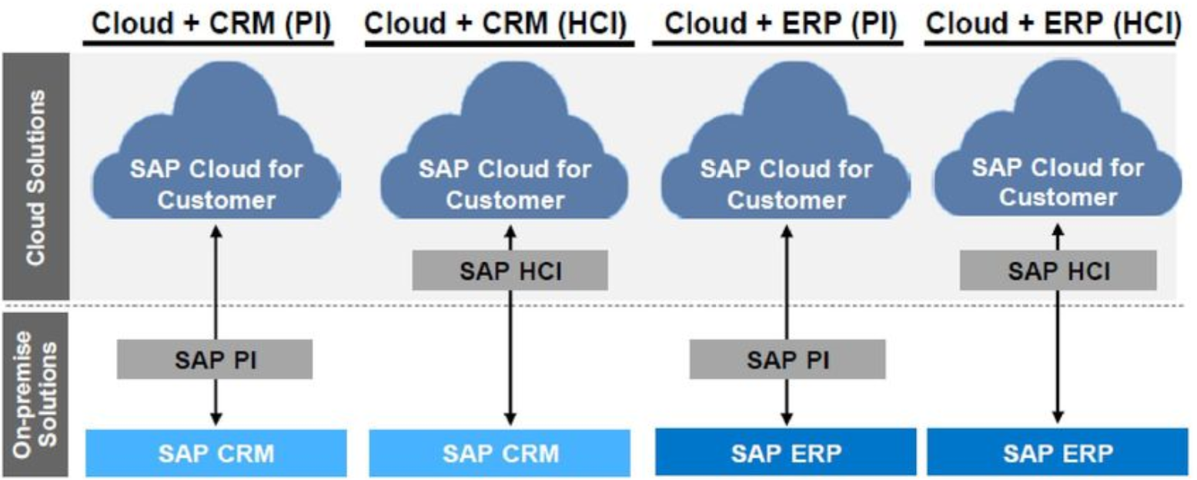
Extension – Integration - Webservices

Slide 25
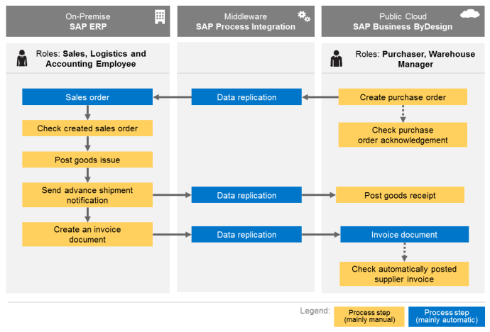
Extension – Integration - Webservices

Slide 26
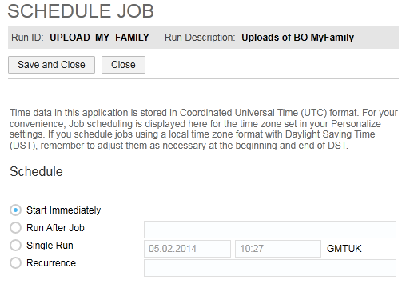
Extension – Integration – XML Input

Slide 27
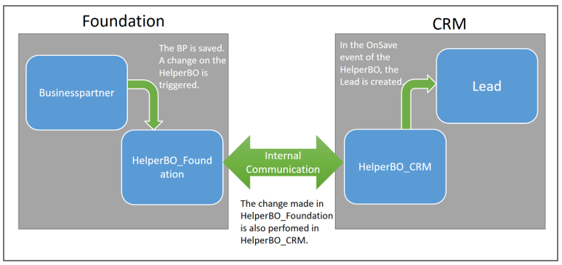
Extension – Integration – Internal Communication

Slide 28
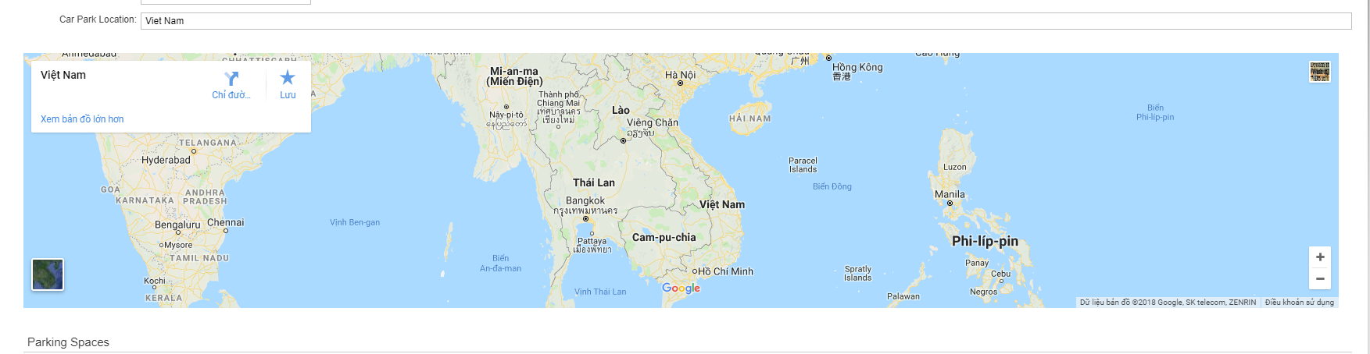
Extension – Integration - Mashup

Slide 29
What is it ?
Architecture
System Landscape
User Roles
Extension
SAP Cloud Application Studio
Resources

Slide 30
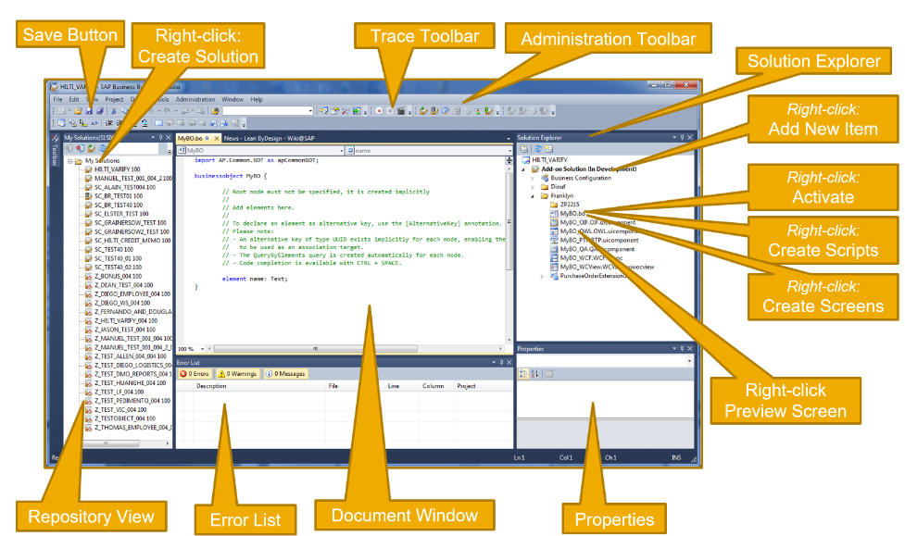
SAP Cloud Application Studio – Overview

Slide 31
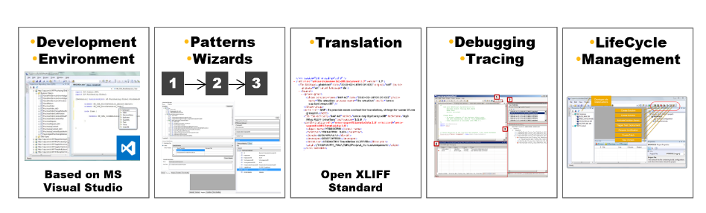
SAP Cloud Application Studio – Key Features

Slide 32
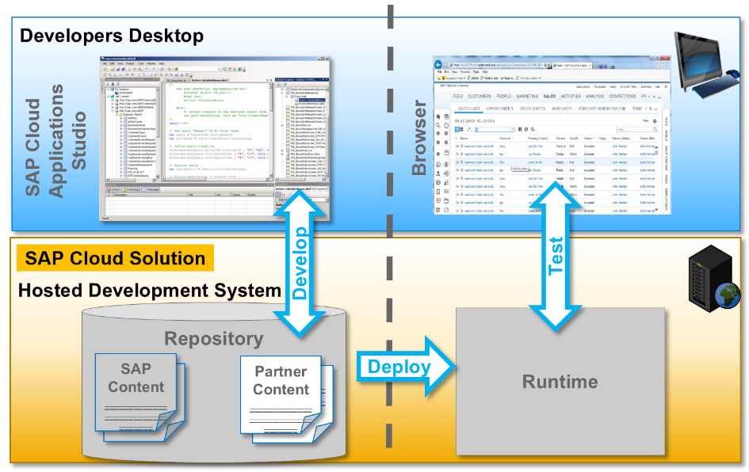
SAP Cloud Application Studio – How does it work ?

Slide 33
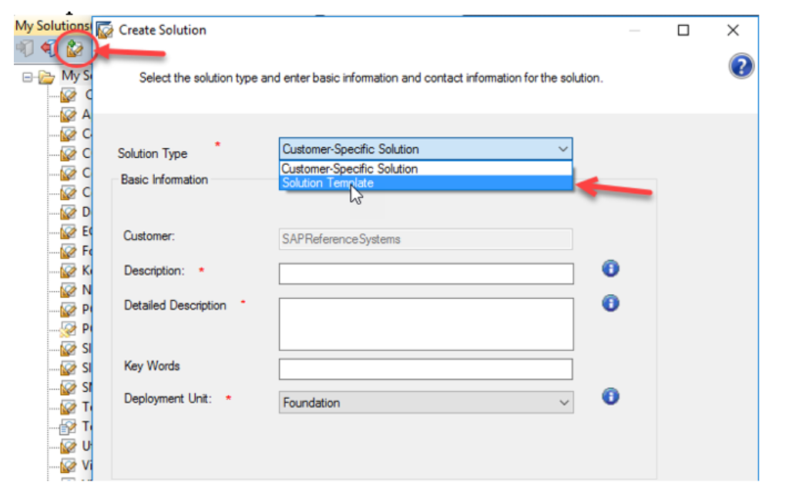
SAP Cloud Application Studio – Solution Types
A solution is the package of development for the SAP Cloud Applications Studio.
It will have the collection of different development objects that you will build and create and maintain.
We can move this content to another tenants, whether it be a test or production.

Slide 34
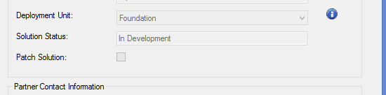

SAP Cloud Application Studio – Deployment Unit

Slide 35
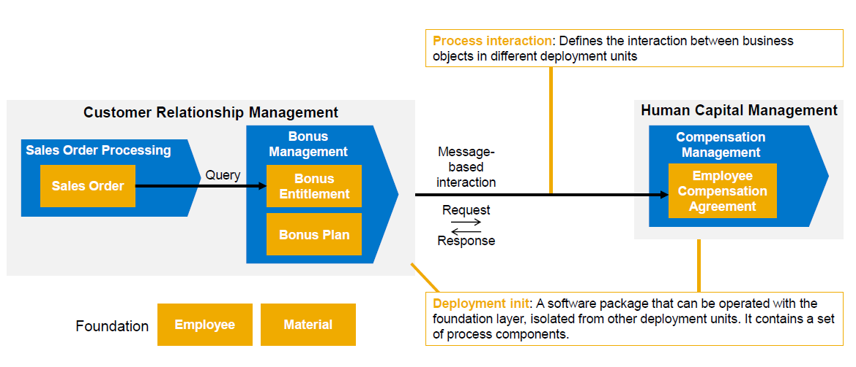
SAP Cloud Application Studio – Deployment Unit

Slide 36
SAP Cloud Application Studio - Customer-specific solution
Main type of solution that we’ll work with in the Cloud Applications Studio
Contains development items for a specific customer
Can contain items requiring “Admin Mode”
Can be deployed to the customer’s production tenant
All content is solution-specific, cannot be used for another customer

Slide 37
SAP Cloud Application Studio - Solution Template
Contains development items for reuse like BO, actions…
Easily start development of customer-specific solutions by reusing
Development can continue through upgrades
Can continue to maintain it through each release and can be updated and deployed over and again
No need for creating a patch, it can be downloaded and uploaded
You can import a solution template into the studio version in which it has been created and into the two subsequent versions

Slide 38
SAP Cloud Application Studio – Programming Languages
ABSL (Advanced Business Script Language)
BODL (Business Object Description Language)

Slide 39
SAP Cloud Application Studio – BODL
A business object is an entity of significance to a business. For example: Sales Order, Employee, Product…
Business objects contain:
Nodes
Elements
Associations
Actions.

Slide 40
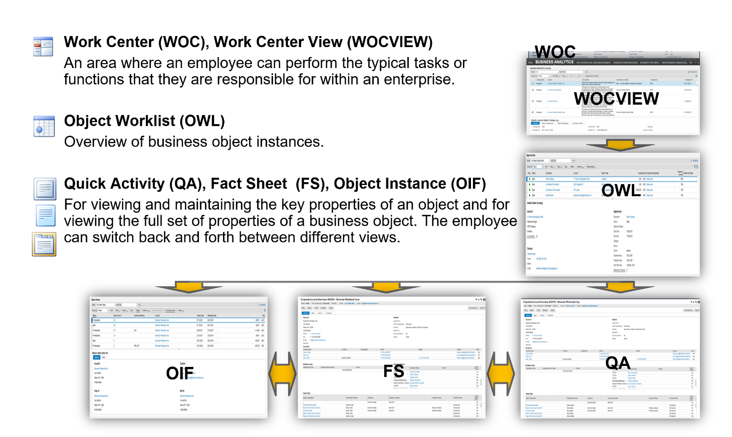
SAP Cloud Application Studio – BODL

Slide 41
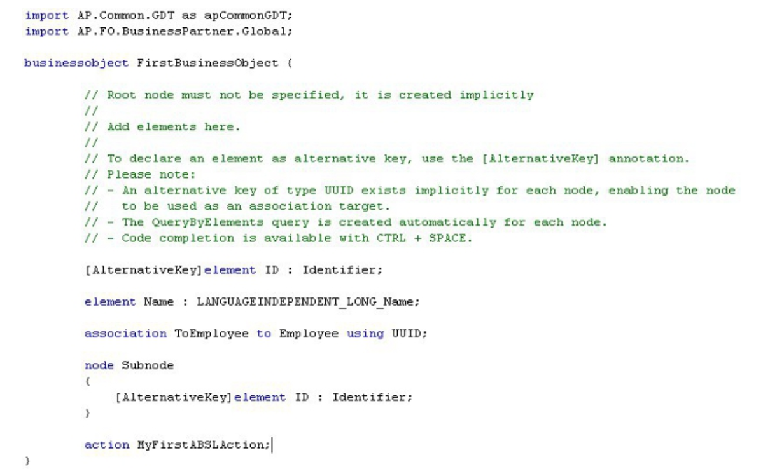
SAP Cloud Application Studio – BODL

Slide 42
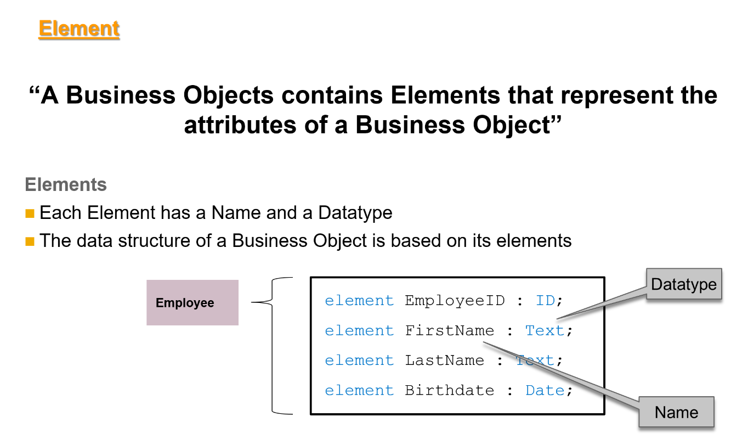
SAP Cloud Application Studio – BODL

Slide 43
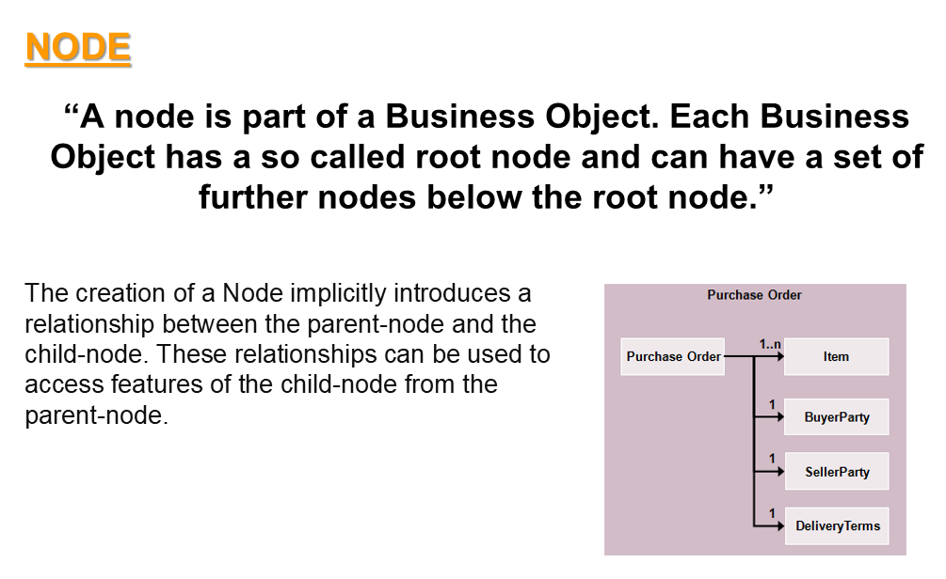
SAP Cloud Application Studio – BODL

Slide 44
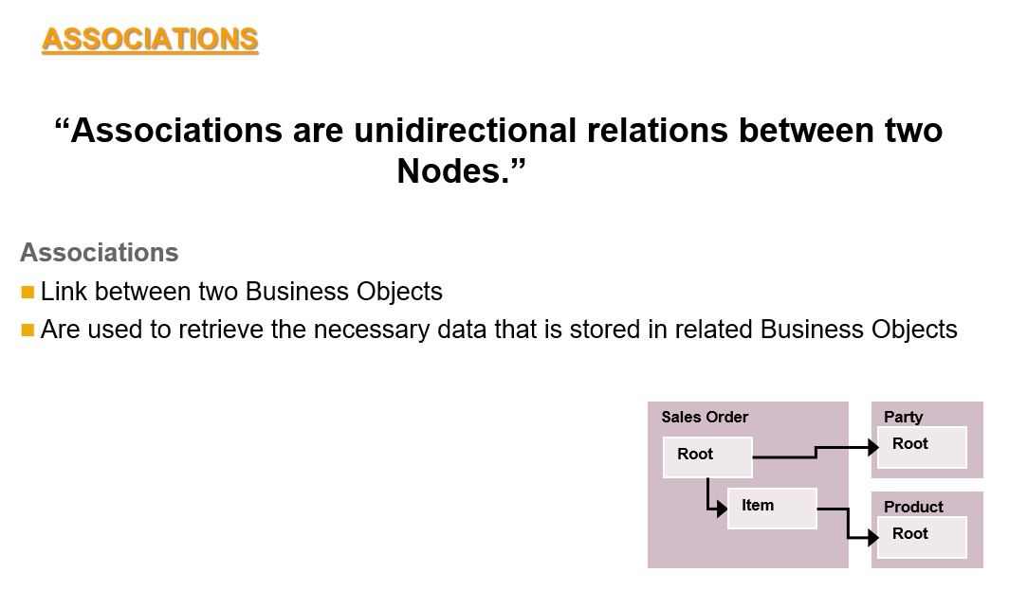
SAP Cloud Application Studio – BODL

Slide 45
SAP Cloud Application Studio – ABSL, Actions, Events
ABSL can apply with:
Actions
Events
AfterLoading: Is executed when a document is loaded (buffer is filled, UI is not yet displayed)
AfterModify: Is executed for each node update. Can generate long loops when updating other nodes.
BeforeSave: Is executed for each node save. Not as expensive as the AfterModify.
Validation
OnSave: is used to check if particular conditions are fulfilled, such as the conditions for saving a business object node.

Slide 46
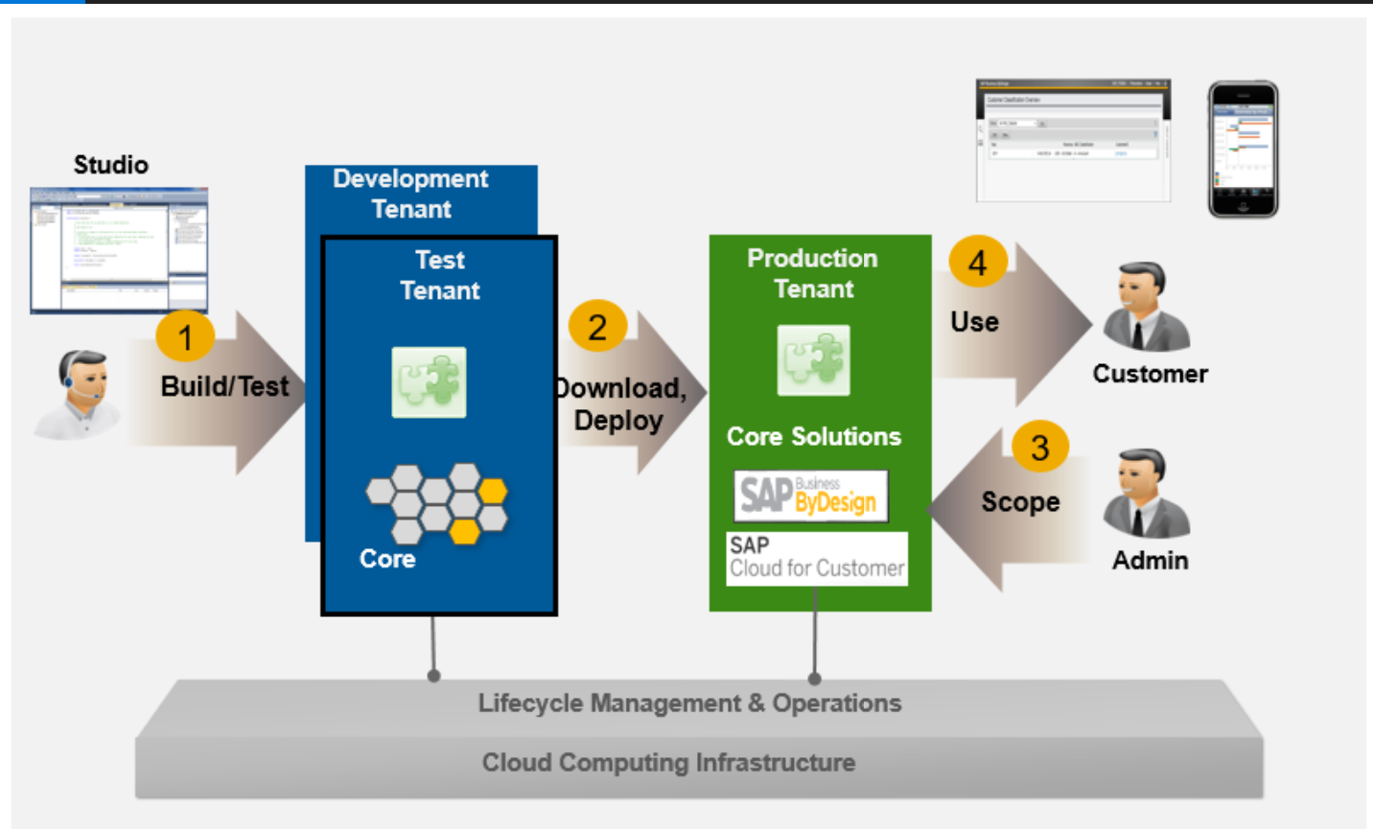
SAP Cloud Application Studio – Life Cycle Management

Slide 47
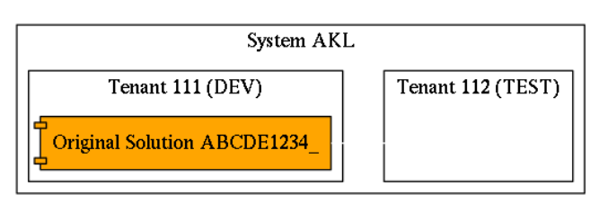
SAP Cloud Application Studio – Life Cycle Management

Slide 48
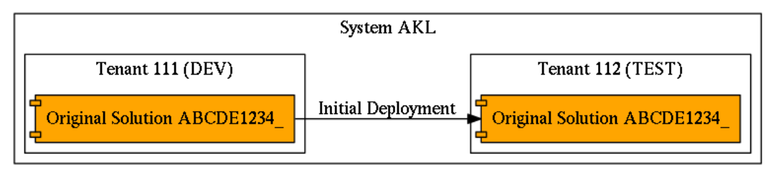
SAP Cloud Application Studio – Life Cycle Management

Slide 49
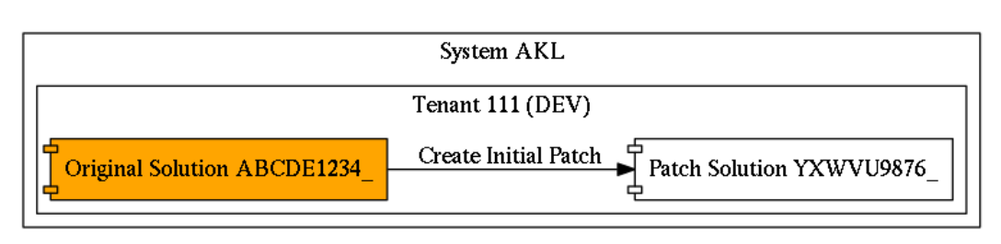
SAP Cloud Application Studio – Life Cycle Management

Slide 50
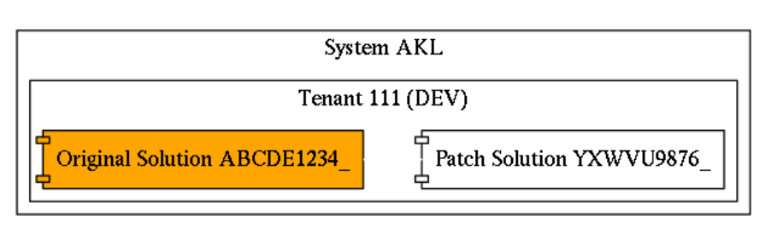
SAP Cloud Application Studio – Life Cycle Management

Slide 51
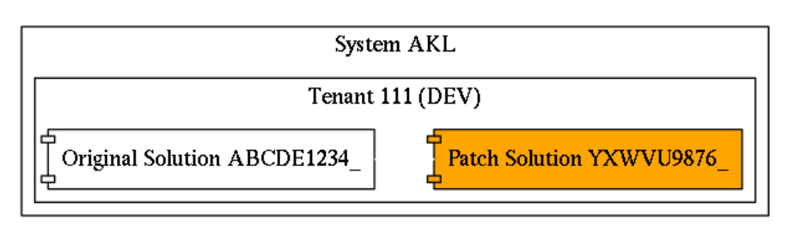
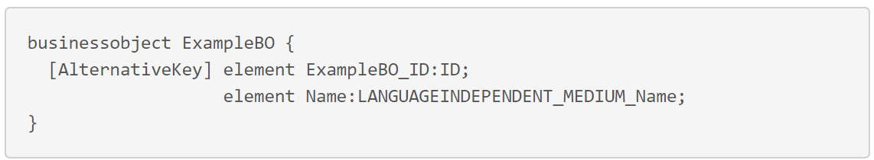
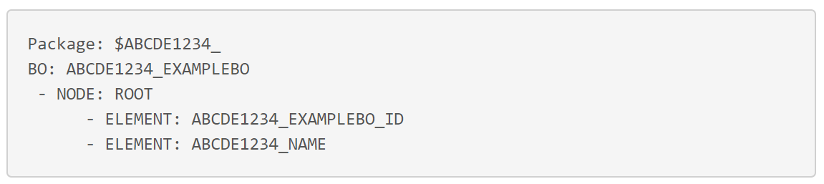
SAP Cloud Application Studio – Life Cycle Management

Slide 52
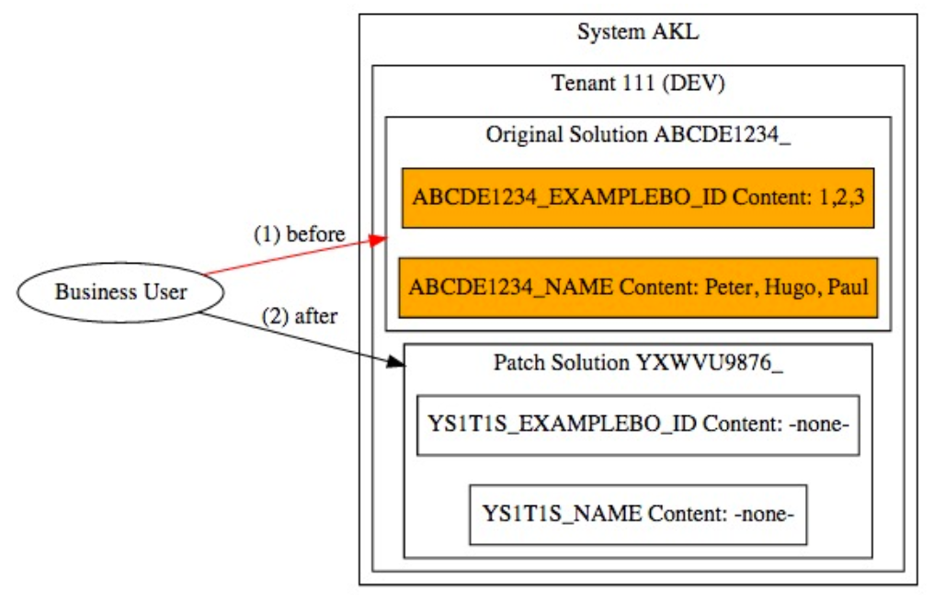
SAP Cloud Application Studio – Life Cycle Management

Slide 53
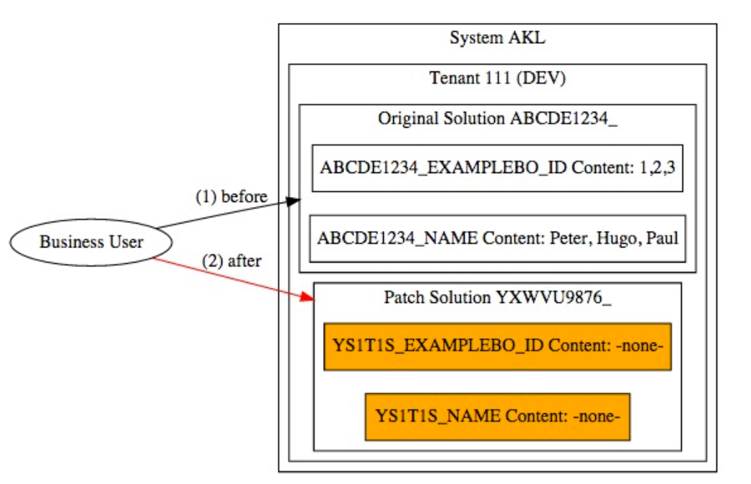
SAP Cloud Application Studio – Life Cycle Management

Slide 54
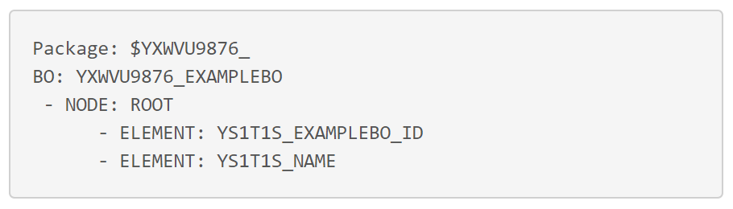
SAP Cloud Application Studio – Life Cycle Management

Slide 55
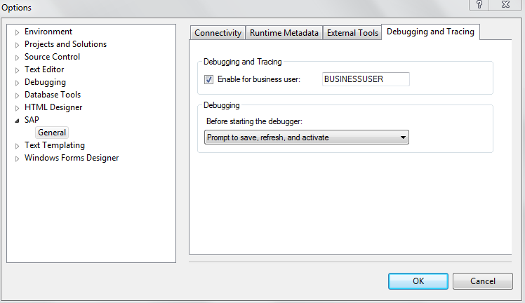
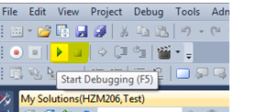
SAP Cloud Application Studio – Debug

Slide 56
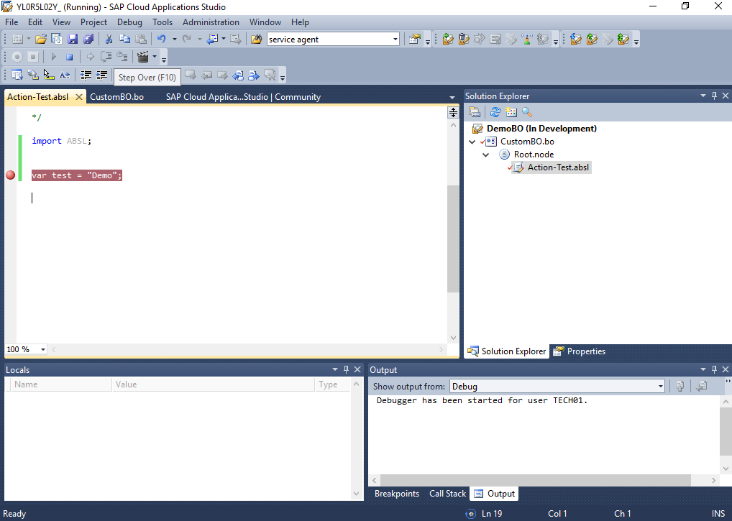
SAP Cloud Application Studio – Debug

Slide 57
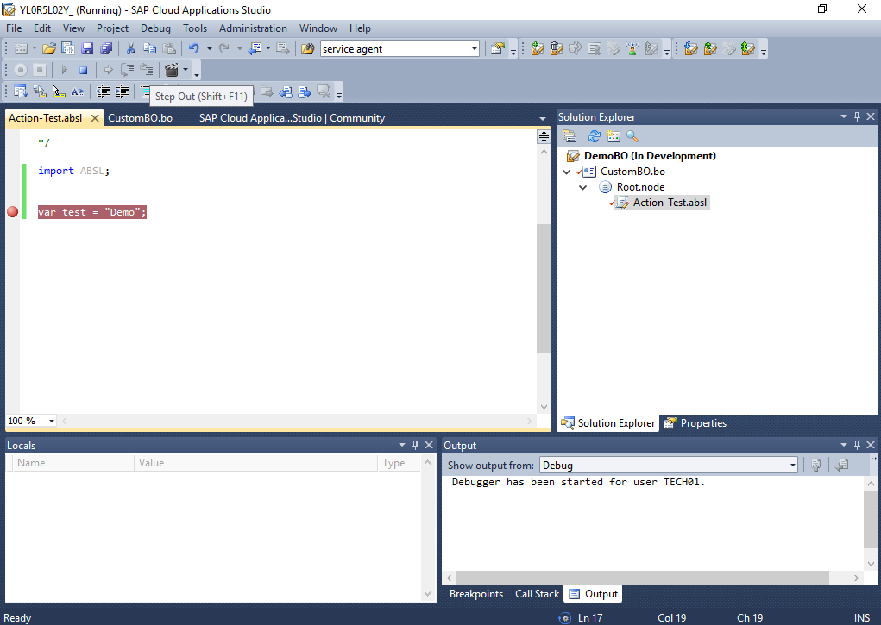
SAP Cloud Application Studio – Debug

Slide 58
What is it ?
Architecture
System Landscape
User Roles
Extension
SAP Cloud Application Studio
Resources

Slide 59
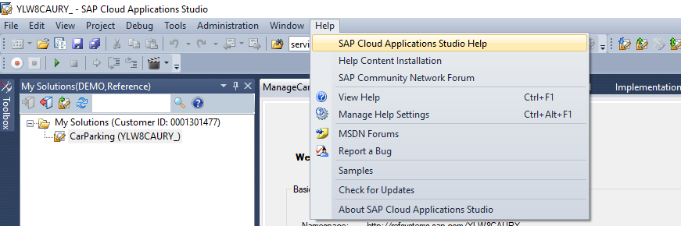
Resources
1. SAP Cloud Applications Studio Help

Slide 60

Resources
2. Introduction into SAP Business ByDesign
Notes:
https://www.sap.com/assetdetail/2018/01/bc9f16e0-ee7c-0010-82c7-eda71af511fa.html

Slide 61

Resources
3. openSAP Courses
Notes:
https://open.sap.com/courses?q=SAP%20Bydesign

Slide 62

Resources
4. SAP ByDesign Video Channel

Slide 63

Resources
5. SAP CloudDev
Notes:
https://www.youtube.com/watch?v=2wX3RRESBaE&list=PLAN4lvL4kFnh45xtdaBbDbxVLfITqQixH

Slide 64

Q&A

Slide 65
Thank You !

